Slide 1
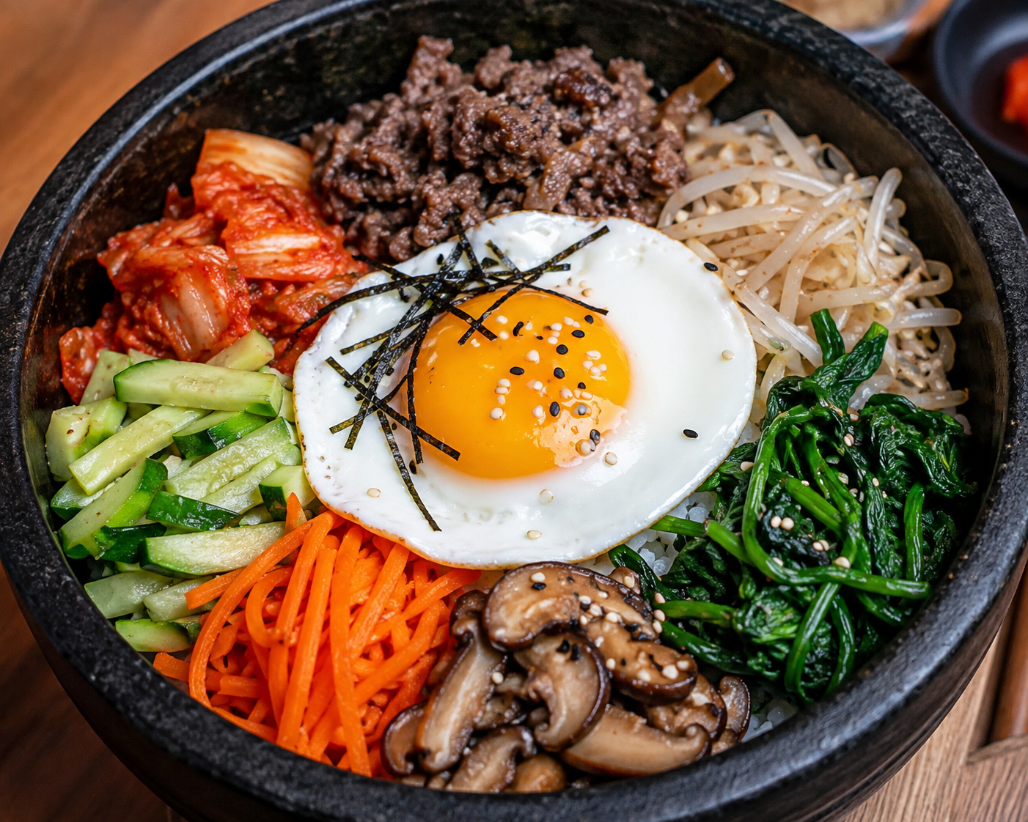
LUNCH SPECIALS
October 5th-9th
MONDAY | TUESDAY | WEDNESDAY | THURSDAY | FRIDAY
Spotlight
Bao Buns Cucumber Salad / Scallion Sesame Rice Lemongrass Chicken/ Braised Pork Belly/Crispy Coconut Tofu Pickled Red Onion/Cucumber/Peanuts/Cilantro/Scallion/Crispy Shallots Hoisin/Sriracha Aioli
Streat's
Hearth
PIZZAS: Pepperoni | Vegetable V | Classic Cheese V SPECIALTY
Explore
Italian | Southern | Homestyle Cookery | BBQ | Autumnal
Ladle
Lemon Chicken and Orzo | Lemon Chicken and Orzo | Lemon Chicken and Orzo | Lemon Chicken and Orzo | Lemon Chicken and Orzo
HIGHLIGHTS
Western Burger Onion Rings, Bacon, BBQ Sauce, Smoked Gouda, Texas Toast | Classic BLT | Crispy Chicken Taco Bibb Lettuce, Honey Mustard, Tomato, Flour Tortilla | Eggplant Parmesan | Breakfast All Day
MORE MENUS
BREAKFAST
Caesar Pizza | Burrata and Tomato Pizza | Lardon, Poached Egg, Whole Grain Mustard Bechamel | Red Curry Shrimp Pizza | BBQ Chicken Pizza
FULL EXPLORE
THE COUNTER
ENERGIZE FOR LIFE

Slide 2
Explore
October 5th-9th
MONDAY Italian | TUESDAY Southern | WEDNESDAY Homestyle Cookery | THURSDAY BBQ | FRIDAY Autumnal
Tortellini Bolognese Parmesan Roasted Broccoli with Calabrian Chili Aioli Zucchini, Eggplant, Broccoli Rabe, and Cherry Tomato Caprese Salad, Garlic Bread | Nashville Hot Chicken Mac and Cheese Baked Beans Banana Pudding, Broccoli Salad | Honey Garlic Shrimp Buffalo Brussel Sprouts Steamed Rice Fennel-Apple Salad, Multigrain Rolls | Braised BBQ Beef Pastrami Spiced Carrots Smashed Potatoes Corn Bread, Macaroni Salad | Grilled Chicken Thighs with Pears and Balsamic Glaze Roasted Butternut Squash with Dried Cranberries Rice Pilaf Apple Coleslaw

Slide 3
BREAKFAST
October 5th-9th
MONDAY | TUESDAY | WEDNESDAY | THURSDAY | FRIDAY
Hot Cereal Oatmeal, Cream of Wheat Dried Cranberries, Brown Sugar, Vermont Maple Syrup, Toasted Almonds, Granola, Toasted Puffed Rice, Nori, Chia, Flax Seed Pastries Muffins, Danish, Croissants Seasonal Fruit & Berries, Greek Yogurt, Overnight Oats, Cottage Cheese, Tomato, Assorted Cheese, Bermuda Onion, Bagel Bar Assorted Bagels, Harvest Bread: Daily Toast, Cream Cheese, House Vege Cream Cheese, Assorted Jams, Nut Butters Breakfast Special
Pumpkin Spice Pancake | Zucchini Pie with Whipped Ricotta | Steak, Egg, and Cheese Empanada | Espresso French Toast | Sausage, Egg, and Cheese McGriddle
Daily Breakfast Sandwiches Bacon, Egg, and Cheese on a Croissant Egg and Cheese on English Muffin Sausage, Egg, and Cheese on a Biscuit Tater Tots Roasted Mushroom

Slide 4
Lunch
October 5th-9th
MONDAY | TUESDAY | WEDNESDAY | THURSDAY | FRIDAY
The Market Table Variety of Salad Greens & Vegetable Crudités Seasonal Antipasti Fruit, Beans, Alternative Proteins, Cheese, Crispy Toppings & Dried Fruit Seasonal House Made Dressings Daily Hot Market
Roasted Baby Carrots | Roasted Baby Carrots | Roasted Baby Carrots | Roasted Baby Carrots | Roasted Baby Carrots
24 Hour Brined Grilled Chicken Pearl Couscous

Slide 5
Streat’s
Streat’s
October 5th-9th
MONDAY | TUESDAY | WEDNESDAY | THURSDAY | FRIDAY
Grill Menu RA Signature Burger American Cheese, Bibb Lettuce, Tomato, Comeback Sauce, Martin’s Potato Bun Grilled 24 Hour Brined Chicken Apple Smoked Bacon, Avocado, lettuce, Tomato, Red Onion Lentil Chickpea Burger Dijonnaise, Bibb Lettuce, Tomato, Pickled Red Onion, Toasted Brioche Daily Specials
Western Burger Onion Rings, Bacon, BBQ Sauce, Smoked Gouda, Texas Toast | Classic BLT | Crispy Chicken Taco Bibb Lettuce, Honey Mustard, Tomato, Flour Tortilla | Eggplant Parmesan | Breakfast All Day
Daily Sides Roasted Fall Vegetables Charred Asparagus Simple Greens

Slide 6
SANDWICH SPECIALS
October 5th-9th
WEEKLY Menu
Grilled Casesar Wrap Romaine, Shaved Parmesan, Caesar Dressing Smoked Turkey Sandwich Bibb Lettuce, Heirloom Tomato, Pepperjack, Chipotle Aioli The Focaccia Native Tomatoes, Fresh Mozzarella, Basil Pesto, Arugula, Toasted Focaccia Kettle Chips Specials
Jerk Tofu Sandwich Coconut Slaw, Scallion Aioli, Ciabatta | Grilled Chicken Sandwich Bibb Lettuce, Pickled Red Onion, Avocado, Bacon, Alabama BBQ | Pastrami Reuben Coleslaw, Swiss, Thousand Island, Marble Rye | Crispy Buffalo Chicken Flatbread | Chicken Milanese Fresh Mozzarella, Roasted Pepper, Fresh Basil, Balsamic Glaze

Slide 7
energize for life
Daily Curated Bowls
October 5th-9th
WEEKLY SPECIALS
Monday - BYO Acai Bowl Strawberry, Blueberry, Banana, Pineapple, Peanut Butter, Granola, Coconut Flakes, Flax Seeds, Slivered Almonds Tuesday –Lemon Oregano Chicken Greek Bowl Lemon Rice, Hummus, Babagahnous, Tzatziki, Cucumber Salad, Pickled Red Onions, Pita Chips, Grape Leaves, Tahini Dressing, Harissa Vinaigrette Wednesday – Falafel Greek Bowl Lemon Rice, Hummus, Babagahnous, Tzatziki, Cucumber Salad, Pickled Red Onions, Pita Chips, Grape Leaves, Tahini Dressing, Harissa Vinaigrette Thursday –Lemon Oregano Shrimp Greek Bowl Lemon Rice, Hummus, Babagahnous, Tzatziki, Cucumber Salad, Pickled Red Onions, Pita Chips, Grape Leaves, Tahini Dressing, Harissa Vinaigrette Friday – BYO Acai Bowl Strawberry, Blueberry, Banana, Pineapple, Peanut Butter, Granola, Coconut Flakes, Flax Seeds, Slivered Almonds

